Slide 1
POLLUTION
Pollution is the introduction of harmful materials into the environment. These harmful materials are called pollutants. Pollutants can be natural, such as volcanic ash. They can also be created by human activity, such as trash or runoff produced by factories.

Slide 2
POLLUTION is a very hamrfull for human,animals & and our earth.
There are many types of pollution
AIR POLLLUTION
WATER POLLUTION
NOISE POLLUTIUON
LAND POLLUTION
THERMAL POLLUTION
LIGHT POLLUTION

Slide 3
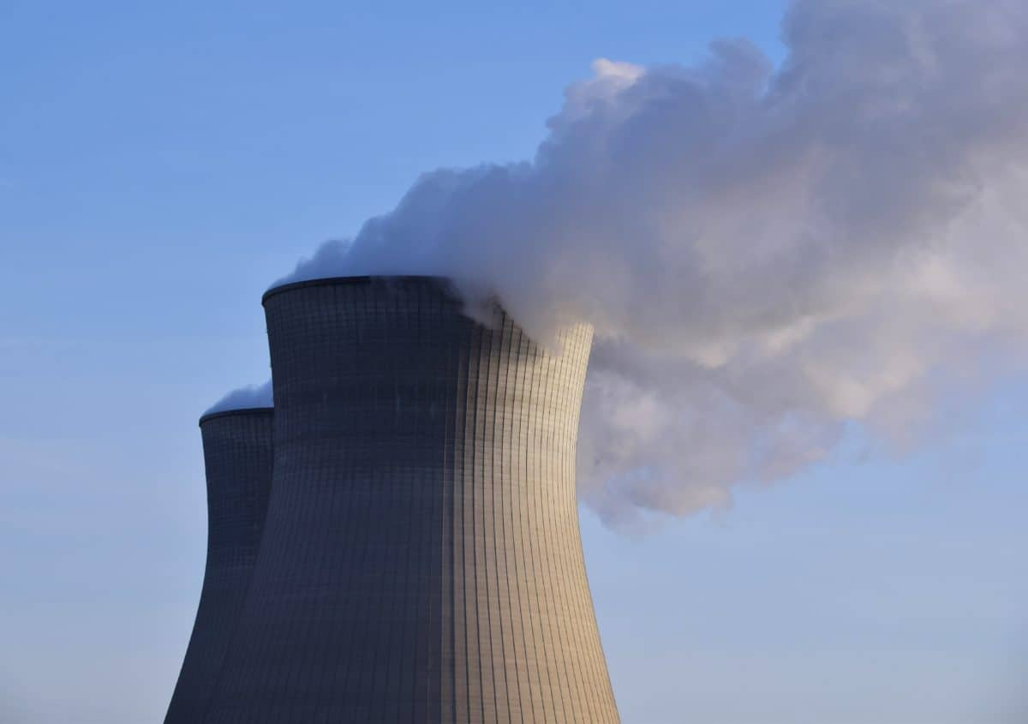
AIR POLLUTION
Air pollution is one of the greatest environmental risk to health. By reducing air pollution levels, countries can reduce the burden of disease from stroke, heart disease, lung cancer, and both chronic and acute respiratory diseases, including asthma.
In 2019, 99% of the world’s population was living in places where the WHO air quality guidelines levels were not met.
The combined effects of ambient air pollution and household air pollution are associated with 6.7 million premature deaths annually.
Ambient (outdoor) air pollution is estimated to have caused 4.2 million premature deaths worldwide in 2019.
Some 89% of those premature deaths occurred in low- and middle-income countries, and the greatest number in the WHO South-East Asia and Western Pacific Regions.
Policies and investments supporting cleaner transport, energy efficient homes, power generation, industry and better municipal waste management would reduce key sources of outdoor air pollution. Access to clean household energy would also greatly reduce ambient air pollution in some regions.

Slide 4
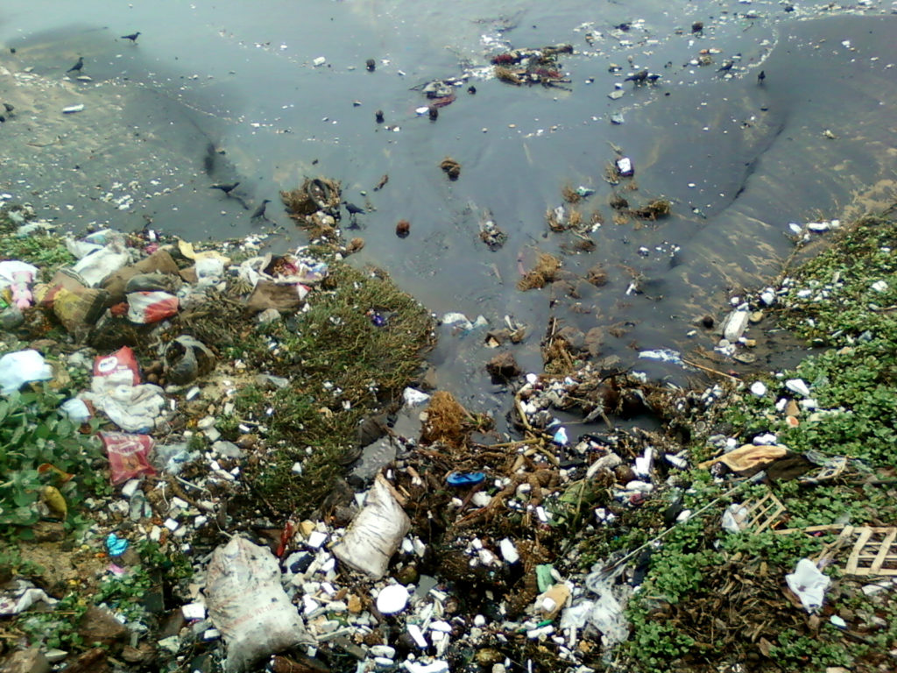
WATER POLLUTION
Water pollution occurs when harmful substances—often chemicals or microorganisms—contaminate a stream, river, lake, ocean, aquifer, or other body of water, degrading water quality and rendering it toxic to humans or the environment.
This widespread problem of water pollution is jeopardizing our health. Unsafe water kills more people each year than war and all other forms of violence combined. Meanwhile, our drinkable water sources are finite: Less than 1 percent of the earth’s freshwater is actually accessible to us. Without action, the challenges will only increase by 2050, when global demand for freshwater is expected to be one-third greater than it is now.

Slide 5

NOISE POLLUTION
Noise pollution, or sound pollution, is the propagation of noise or sound with ranging impacts on the activity of human or animal life, most of which are harmful to a degree. The source of outdoor noise worldwide is mainly caused by machines, transport and propagation systems. Poor urban planning may give rise to noise disintegration or pollution, side-by-side industrial and residential buildings can result in noise pollution in the residential areas. Some of the main sources of noise in residential areas include loud music, transportation (traffic, rail, airplanes, etc.), lawn care maintenance, construction, electrical generators, wind turbines, explosions and people.

Slide 6
THERMAL POLLUTION
Thermal pollution, sometimes called "thermal enrichment", is the degradation of water quality by any process that changes ambient water temperature. Thermal pollution is the rise or drop in the temperature of a natural body of water caused by human influence. Thermal pollution, unlike chemical pollution, results in a change in the physical properties of water. A common cause of thermal pollution is the use of water as a coolant by power plants and industrial manufacturers.Urban runoff—stormwater discharged to surface waters from rooftops, roads, and parking lots—and reservoirs can also be a source of thermal pollution. Thermal pollution can also be caused by the release of very cold water from the base of reservoirs into warmer rivers.

Slide 7
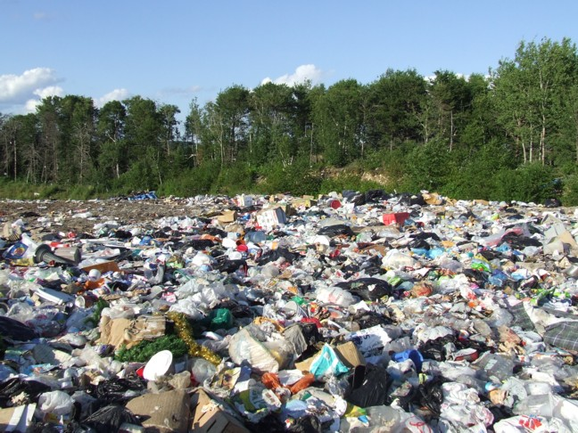
LAND POLLUTION
Land pollution refers to the deterioration of the earth’s land surfaces at and below ground level. It is caused by the accumulation of solid and liquid waste materials that contaminate groundwater and soil. These waste materials are often referred to as municipal solid waste (MSW), which includes both hazardous and non-hazardous waste.
As different waste materials and pollutants like heavy metals, pesticides, plastic, litter and pharmaceuticals sit on top of and leach into our soil, they change and degrade its natural composition. Over time, some pollutants can also go through a chemical transformation, creating secondary pollutants like fumaric and phthalic acids.
The permeability of the soil formations below the waste can increase or reduce the risk of land pollution. The higher the permeability of the soil, the more likely that land pollution will occur. Meanwhile, extreme weather events like hurricanes and floods can exacerbate the effects of land pollution as they disperse or concentrate certain pollutants.

Slide 8

LIGHT POLLUTION
Light pollution is the presence of any unwanted, inappropriate, or excessive artificial lighting. In a descriptive sense, the term light pollution refers to the effects of any poorly implemented lighting sources, during the day or night. Light pollution can be understood not only as a phenomenon resulting from a specific source or kind of pollution, but also as a contributor to the wider, collective impact of various sources of pollution.

